Slide 1
IT694
Computer Networks
Week4_Lec2_HTTP-II

Slide 2


Maintaining user/server state: cookies
Recall: HTTP GET/response interaction is stateless
no tracking “state” of multi-step exchange
all HTTP requests are independent of each other
no need for client/server to “recover” from a partially-completed-but-never-completely-completed transaction
a stateful protocol: client makes two changes to X, or none at all
X
lock data record X
X
OK
update X X’
X’
OK
t’
update X X’’
OK
X’’
unlock X
OK
X’’
time
time
Q: what happens if network connection or client crashes at t’ ?
Notes:
t’

Slide 3
Maintaining user/server state: cookies
Web sites and client browser use cookies to maintain some state between transactions
four components:
1) cookie header line of HTTP response message
2) cookie header line in next HTTP request message
3) cookie file kept on user’s host, managed by user’s browser
4) back-end database at Web site
Example:
User → browser on laptop,
e-commerce site for first time
when initial HTTP requests arrives at site, site creates:
unique ID (aka “cookie”)
entry in backend database for ID
subsequent HTTP requests from User to this site
cookie ID value, allowing site to “identify” User
Notes:
t’

Slide 4
Maintaining user/server state: cookies
client
Amazon server
ebay 8734
usual HTTP request msg
Amazon server
creates ID
1678 for user
cookie file
usual HTTP response
set-cookie: 1678
backend
database
create
entry
ebay 8734
amazon 1678
usual HTTP request msg
cookie: 1678
cookie-
specific
action
access
usual HTTP response msg
one week later:
access
ebay 8734
amazon 1678
usual HTTP request msg
cookie: 1678
cookie-
specific
action
usual HTTP response msg
time
time
Notes:
t’

Slide 5
HTTP cookies: comments
aside
What cookies can be used for:
authorization
shopping carts
recommendations
user session state (Web e-mail)
cookies and privacy:
cookies permit sites to learn a lot about you on their site.
third party persistent cookies (tracking cookies) allow common identity (cookie value) to be tracked across multiple web sites
Challenge: How to keep state?
at protocol endpoints: maintain state at sender/receiver over multiple transactions
in messages: cookies in HTTP messages carry state
Notes:
t’

Slide 6
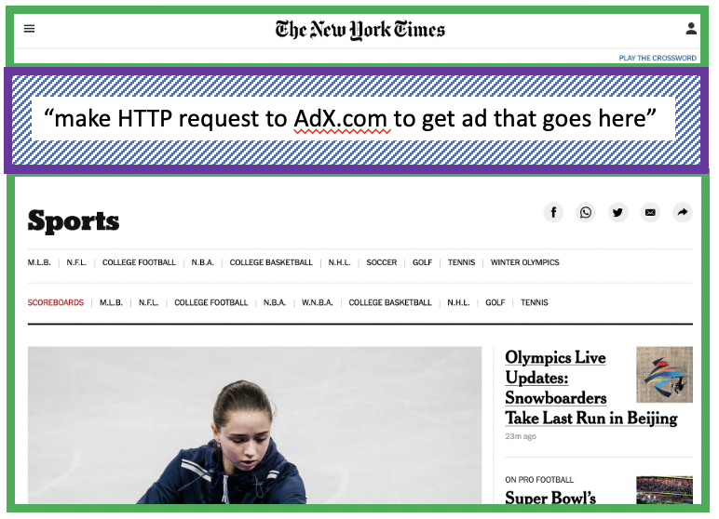
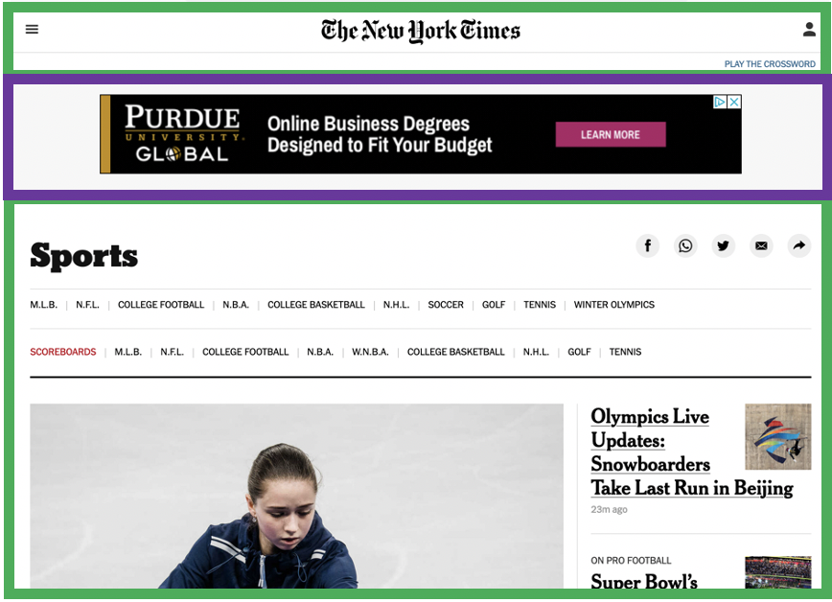


Example: displaying a NY Times web page
1
GET base html file from nytimes.com
2
fetch ad from AdX.com
nytimes.com
4
5
HTTP GET
1
2
HTTP reply
7
display composed page
3
4
6
5
NY times page with embedded ad displayed
AdX.com

Slide 7
Cookies: tracking a user’s browsing behavior
1634: sports, 2/15/22
nytimes.com (sports)
“first party” cookie – from website you chose to visit (provides base html file)
HTTP
GET
HTTP reply
Set cookie: 1634
HTTP GET
Referrer: NY Times Sports
4
5
7493: NY Times sports, 2/15/22
“third party” cookie – from website you did not choose to visit
HTTP reply
NY Times: 1634
Set cookie: 7493
AdX.com
AdX: 7493

Slide 8
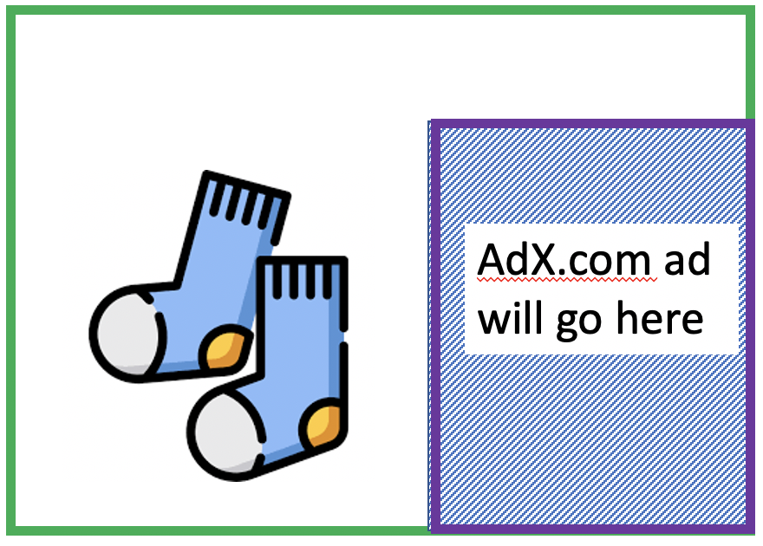
Cookies: tracking a user’s browsing behavior
1634: sports, 2/15/22
nytimes.com
AdX:
tracks my web browsing over sites with AdX ads
can return targeted ads based on browsing history
socks.com
HTTP reply
2
HTTP GET
1
HTTP GET
Referrer: socks.com, cookie: 7493
4
7493: NY Times sports, 2/15/22
5
7493: socks.com, 2/16/22
HTTP reply
NY Times: 1634
Set cookie: 7493
AdX.com
AdX: 7493

Slide 9

Cookies: tracking a user’s browsing behavior (one day later)
1634: sports, 2/15/22
1634: arts, 2/17/22
nytimes.com (arts)
socks.com
HTTP
GET
HTTP reply
cookie: 1634
Set cookie: 1634
HTTP GET
Referrer: nytimes.com, cookie: 7493
4
7493: NY Times sports, 2/15/22
5
7493: socks.com, 2/16/22
HTTP reply
7493: NY Times arts, 2/15/22
NY Times: 1634
Set cookie: 7493
AdX.com
AdX: 7493
Returned ad for socks!

Slide 10
Cookies: tracking a user’s browsing behavior
Cookies can be used to:
track user behavior on a given website (first party cookies)
track user behavior across multiple websites (third party cookies) without user ever choosing to visit tracker site (!)
tracking may be invisible to user:
rather than displayed ad triggering HTTP GET to tracker, could be an invisible link
third party tracking via cookies:
disabled by default in Firefox, Safari browsers
to be disabled in Chrome browser in 2023

Slide 11
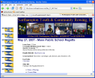
Web caches
Goal: satisfy client requests without involving origin server
user configures browser to point to a (local) Web cache
browser sends all HTTP requests to cache
if object in cache: cache returns object to client
else cache requests object from origin server, caches received object, then returns object to client
Web
cache
HTTP request
HTTP request
client
HTTP response
HTTP response
origin
server
HTTP request
HTTP response
client
Notes:
t’

Slide 12


Web caches (aka proxy servers)
Web cache acts as both client and server
server for original requesting client
client to origin server
Why Web caching?
reduce response time for client request
cache is closer to client
reduce traffic on an institution’s access link
Internet is dense with caches
enables “poor” content providers to more effectively deliver content
server tells cache about object’s allowable caching in response header:
Notes:
re: poor content providers – like in real-estate, location is everything. servers want to be close to clients.

Slide 13

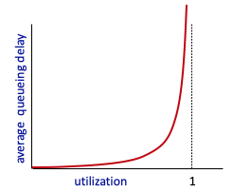

Drawbacks of no CACHE
The traffic intensity on the LAN is
(15 requests/sec)*(1 Mbits/request)/(100 Mbps) = 0.15
The traffic intensity on the access link (from the Internet router to institution router) is
(15 requests/sec)*(1 Mbits/request)/(15 Mbps) = 1
origin
servers
public
Internet
15 Mbps
access link
Option 1: buy a faster access link
institutional
network
1 Gbps LAN
Option 2: install a web cache

Slide 14
Option 2: install a web cache: cheaper alternative
Typically, 40% of requests addressed by CACHE
Remaining 60% origin servers.
But traffic intensity reduced from 1 to 0.6
Fuurther reduce the delay
origin
servers
public
Internet
1.54 Mbps
access link
institutional
network
1 Gbps LAN
local web cache

Slide 15
Browser caching: Conditional GET
client
server
Goal: don’t send object if browser has up-to-date cached version
no object transmission delay (or use of network resources)
client: specify date of browser-cached copy in HTTP request
If-modified-since: <date>
server: response contains no object if browser-cached copy is up-to-date:
HTTP/1.0 304 Not Modified
HTTP request msg
If-modified-since: <date>
object
not
modified
before
<date>
HTTP response
HTTP/1.0
304 Not Modified
HTTP request msg
If-modified-since: <date>
object
modified
after
<date>
HTTP response
HTTP/1.0 200 OK
<data>
Notes:
t’

Slide 16
Example of Conditional GET
a proxy cache sends a request message to a Web server:
A week later, another browser requests the same object via the cache, and the object is still in the cache.
The cache performs an up-to-date check
issuing a conditional GET.
Specifically, the cache sends:
the Web server sends a response message with the requested object to the cache:
Web server sends a response message to the cache:

